Slide 1
Columbus Healthcare
Name
Institution
Course
Instructor
Date

Slide 2
SBAR Proposal
Situation
Columbus is one of the cities which have experienced the impact of the pandemic.
Many people residing in cities close to Columbus have been seeking better medical attention in the hospitals within the city.
This has led to increased waiting time and shortage of beds in the hospitals.
Background
The increase in the general amount of time one has to wait in line before receiving services shows inefficiency in the delivery of services.
Increased waiting time has also increased congestion in the hospitals which can be risky especially during the COVID-19 pandemic.
The COVID-19 has also increased the demand for healthcare services making it even more necessary to provide interventions for increasing the efficiency of service delivery (Mercier, Arquizan, & Roubille, 2020).
Notes:
Situation
The COVID-19 pandemic has undermined the ability of most healthcare systems to efficiently providing services. Columbus is one of the cities which have experienced the impact of the pandemic. The city has various hospital reliable in providing many services (Mercier, Arquizan, & Roubille, 2020). The healthcare system of the town is just efficient in serving the needs of the people living in the town. This means the city has a healthcare system that can serve a population of people below 200,000. In recent years, many people residing in cities close to Columbus have been seeking better medical attention in the hospitals within the city. This has generally led to congestion in the hospitals with more individuals seeking to receive service at the same time. This has led to increased waiting time to almost double due to more people being serviced. There also has been a shortage of beds in the hospitals making the problem even worse.
Background
The amount of time one waits in the hospital before receiving the services they need can indicate how efficient the operations within the hospital are. The increase in the general amount of time one has to wait in line before receiving services shows inefficiency in the delivery of services. Increased waiting time has also increased congestion in the hospitals which can be risky especially during the COVID-19 pandemic. The COVID-19 has also increased the demand for healthcare services making it even more necessary to provide interventions for increasing the efficiency of service delivery (Mercier, Arquizan, & Roubille, 2020).

Slide 3
SBAR Proposal Cont.’
Assessment
The increase in waiting time shows increased number of patients.
The number of healthcare service providers in the state has remained the same regardless of the increase in healthcare service demand.
The number of hospital beds available has also decreased due to the increased population receiving the admission services in the city.
There is a need to increase the number of health service providers and hospital beds in the hospitals around the city.
Recommendations
The department of health can create 100 more vacancies in the city to help in the provision of services.
Distributing the service providers across the different hospitals in the city can help with alleviating the congestion problem (AbuAlRub, 2017).
There is a need to increase the number of hospital beds available in the city.
Notes:
Assessment
The increase in waiting time shows that the number of people receiving services from the hospitals has increased. As many people living outside Columbus have been relying on the healthcare services in the city, more hospitals are likely to be congested. The number of healthcare service providers in the state has remained the same regardless of the increase in demand. This means the service providers have to provide services to more individuals than before. The number of hospital beds available has also decreased due to the increased population receiving the admission services in the city. There is a need to increase the number of health service providers and hospital beds in the hospitals around the city.
Recommendations
The department of health in the city of Columbus can enact various interventions as a way of alleviating the problems associated with the increased demand for healthcare services in the city. Congestion and a low number of vacant hospital beds are some of the key problems associated with the increased demand for healthcare services. The department of health can create 100 more vacancies in the city to help in the provision of services. Distributing the service providers across the different hospitals in the city can help with alleviating the congestion problem (AbuAlRub, 2017). The average annual salary for service providers in Columbus including registered nurses and doctors is $64,097. The annual salary for the 100 additional service providers in the city would be $6400000. This would help in reducing the waiting time as well as congestion in the hospitals. There is a need to increase the number of hospital beds available in the city. 500 hospital beds would cost the healthcare department $887000. These two measures with help in improving the efficiency of service delivery during the pandemic period.

Slide 4
Demographics
Columbus has an estimated population of 898,553 based on 209 reports.
The main ethnic groups are;
  Non-Hispanic (54.3%),
  Black or African American (29%),
  Asian (6.13%), and
  White (3.28%).
  The average household economy in Columbus is $52,971
Notes:
Columbus is one of the most populous cities in the US. In 2019 its population was estimated at 898,553. The main ethnic groups in Columbus are Non-Hispanic (54.3%), black or African American (29%), Asian (6.13%), and White (3.28%). The average household economy in Columbus is $52,971 with males earning 1.34 times higher than females. Columbus has one of the best pediatric hospitals internationally, the best-ranked cancer hospital nationally and it has got two heart hospitals (Oza et al. 2011). The number of other medical centers has also been growing.

Slide 5
Healthcare system and insurance
Health Care and Social Assistance are one of the largest industries in Columbus employing 70,047 people.
172k out of the 843k people live below the poverty line.
91.6% of the people in Columbus have health care coverage.
  There are 50.3% employee plans,
  7.4% on Medicare,
  23% on Medicaid,
  1.21% on military or VA programs,
  8.45% uninsured, and
  9.64% on non-group programs (Oza et al. 2011).
Notes:
Health Care and Social Assistance are one of the largest industries in Columbus employing 70,047 people. 172k out of the 843k people live below the poverty line. Health insurance is a health care system that is used for health service delivery in Columbus. 91.6% of the people in Columbus have health care coverage. There are 50.3% employee plans, 7.4% on Medicare, 23% on Medicaid, 1.21% on military or VA programs, 8.45% uninsured, and 9.64% on non-group programs (Oza et al. 2011). The individual health care spending in Columbus is $8,712 per capita. As compared to other counties, Columbus has the highest diabetes prevalence (19.1%). $4,371 is the personal health care spending by private health insurance, $7,007 is the Medicaid spending on individual health care while $11,038 is the Medicare spending on individual health. All personal health care spending including Medicaid, Private, and Medicare rose from $8,286 to $8,712, a 5.14% growth (Franz et al.2018). The percentage of uninsured people in Columbus decreased from 8.55% to 8.45% in 2017.

Slide 6
Background
Columbus has one of the best pediatric hospitals internationally, the best-ranked cancer hospital nationally and it has got two heart hospitals (Oza et al. 2011).
Many visit the city for healthcare services
Main causes of morbidity and mortality include;
  Infectious diseases
  Injuries
  Child health
Notes:
Columbus is ranked at number 47 in the value of health as compared to other cities. According to the Dashboard, the residents of Columbus live less healthy lives and spend a lot on health care than those in the other cities. The current leading causes of morbidity and mortality in Columbus include infectious diseases (seasonal influenza, sexually transmitted infections, reportable diseases, and Zika virus), injuries (overdose and addiction, youth suicide, injury hospitalization, and violence), and maternal and child health (infant mortality and child fatality review) (Franz et al.2018).

Slide 7
Healthcare issues
Increased demand for healthcare services
Congestion in hospitals due to increased visiting patients
Lack of enough hospital beds to patient admission
Overworking of the available healthcare workers leading to burnout
Notes:
Columbus Georgia is one of the cities whose healthcare systems could be greatly developed by the incorporation of various processes. The city has experienced various challenges due to the high demand for healthcare services from individuals even outside the city. The increase in the number of visiting patients each day has made it difficult for the hospital to efficiently provide healthcare services with the available service providers having more patients to attend to (Gupta, & Denton, 2018). This has contributed to various issues in the city including the burnout of the service providers as well as lack of empty hospital beds. Employee burnout has become a major issue due to overworking the employees.

Slide 8
Recommended actions
Introduction of mobile care clinics
Other recommended actions
  Acquiring more hospital beds
  Hiring more healthcare workers to cater for the increased demand.
Notes:
I would introduce the use of mobile clinics and medical teams to provide screening services for diseases such as cancer and other diseases as well as providing curative services to the vulnerable groups in the city of Columbus. This service will also include responding to childhood adversity and trauma which has not been effectively attended to. This will offer to ensure that the vulnerable and isolated groups get access to the services they need without straining. This service will involve health care providers using vehicles to visit different parts of the city to provide screening services and treat patients who are vulnerable and isolated.

Slide 9
Mobile care clinics
The mobile care clinics provide services on a mobile setting (Franz, et al, 2018).
Services can be taken to the patient’s location
Services will be provide inside a semi-trailer
The trailer has rooms for examination, reception as well as a washroom.
Notes:
Alternative ways of providing services can be implemented to reduce the congestion in the various hospitals within the city. The use of mobile clinics in providing healthcare services is one of the strategies which can improve the efficiency of the healthcare system in the city. The proposed mobile clinics will provide healthcare services in semitrailers to patients around the city.

Slide 10
Designing Health facility
The mobile clinic will use semi-trailers for designing the health facility.
The semi-trailer will give 1,000 square feet of space.
  Sections include;
  Examination room,
  Reception area and
  Washroom.
Notes:
The mobile clinic will use semi-trailers for designing the health facility. The length of these trailers ranges from 40’ to 60’, a width of 8’5” to 12’0” and a GVWR of 68,000 pounds. This will provide the greatest interior space-efficient for building the clinic. The semi-trailer will give 1,000 square feet of space. It will be divided into sections such as examination room, reception area and washroom. Proper and adequate ventilation will be maintained in the semi-trailer. The tractor to move the medical trailer will be removable and will only be rented when locating the medical trailer to a different location.

Slide 11
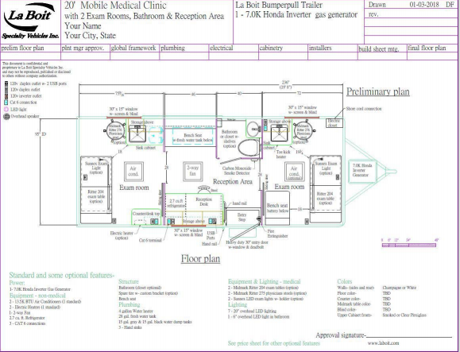
Floor plan
Notes:
The slide shows the diagram for the floor plan of Columbus Healthcare. Different materials will be used for floor finishing depending on different sections of the facility. The main aim is to ensure that the performance requirement is met. For instance, LVT, sheet, and linoleum will be used in examination rooms while the
other rooms will use LVT, bio-based tile, and sheet tile for floor finishing.

Slide 12
Relevant Health processes
Use of EMR/EHR in access to patient medical and health information.
Appointment scheduling (Franz, et al, 2018).
The billing process to transfer payment from insurer to the service providers.
Notes:
The efficiency of services provided through the mobile clinics can be promoted by the proper incorporation of various processes. appointment scheduling is one of the processes which can improve the reliability of the service (Franz, et al, 2018). Appointment scheduling ensures that patients understand the time they should receive the intended services. Proper appointment scheduling can rely on the available software and online websites for the patients to easily schedule appointments. Electronic medical records are also reliable in ensuring better service provision. Electronic medical/ health records provide information about the patients based on their medical history, past diagnosis, possible allergies, and even history of previous diseases and infections. The healthcare system in the city can promote the efficiency of service delivery by ensuring that patient information is easily accessible during service provision. Billing processes are also important in the delivery of care services. The billing process includes process transferring the payment from the insurer to the service provider. Most of the individuals in Columbus have healthcare coverage by different insurers (Gupta, & Denton, 2018).

Slide 13
Cost of implementation
The costs associated with the proposal include;
  Trailer purchase and maintenance
  Travel cots
  Cost of equipment
  Salaries and wages
Notes:
Resources are required in the introduction of the proposed service into the city. Resources will be required in the acquisition of the semi-trailers, catering for travel costs, cost of equipment as well as the cost of acquiring more hospital beds and service providers to cater for the increased demand for healthcare services experienced in the city. Other costs include licensing, salaries, and maintenance.

Slide 14
Sources of funding
Local government grants
Bank loans
Partnership with other organizations e.g pharmaceutical manufacturers
Investor capital
Cutting costs as much as possible.
Notes:
Funding is required to ensure the acquisition of these resources. The proposed sources of funding will include local government grants, bank loans, partnerships with other organizations as well as investor capital (Gupta, & Denton, 2018). Moreover, since I’m affiliating with healthcare system, sharing of resources such as electronic health records and information infrastructure infrastructure is going to help in reduction of costs. Nevertheless, the staffing management could be designated to existing hospital staff instead of hiring a new CEO or the director of nursing. Billing could be done by the hospital billing department which would already have the structure in place for filing claims and collecting for services. Information Technology(IT) infrastructure could be managed by hospital IT department. The main aim is to reduce the cost of operation and increase efficiency.

Slide 15
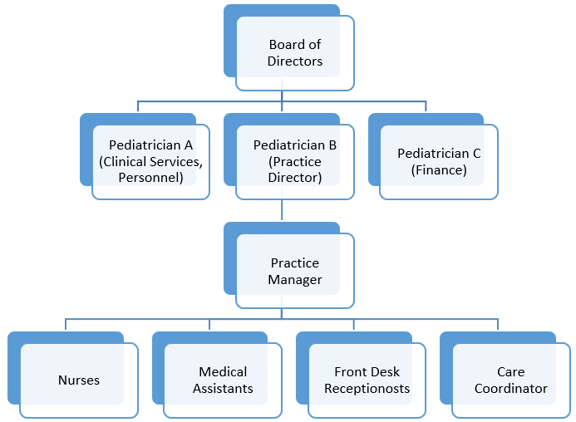
Proposed leadership hierarchy
Notes:
List of roles
Board of directors
The board of directors is responsible for the overall leadership of the facility. This includes decision-making and setting of management policies (Stefl, 2018).
Pediatrician A, B, C
Pediatrician A, B, and C represent the managers of different areas including clinical services, operations, and practice as well as finance. They are responsible for the overall management of each department.
Practice manager
The practice manager is the head of operations and practices carried out by the nurses, medical assistants, receptionists, and care coordinators. The practice manager is guided by the executive decisions made by the board of directors and pediatricians (Stefl, 2018).
Nurses
Nurses play various roles in the facility including assessment of patient needs, formulating the treatment plan for a patient, or diagnosing a disease (Taché, & Chapman, 2016)
Medical assistants
Medical assistants help in undertaking various clinical tasks such as taking a medical history of patients, recording patient's vital signs as well as assisting with administrative tasks in the care facility (Taché, & Chapman, 2016).
Front desk receptionists
The front desk receptionists are the gatekeepers of the healthcare facility. They are responsible for facilitating employee access, answering phone calls, scheduling appointments as well as managing the flow of individuals inside the organization. The reception is the first person one meets after getting into the facility (Hillis, Brenner, Larkin, Cawley, & Connolly, 2016).
Care coordinators
The role of care coordinators is to work with patients after hospital discharge in ensuring that they get to follow-up appointments, any extended therapy required as well as monitoring of the ongoing interventions (Hillis, Brenner, Larkin, Cawley, & Connolly, 2016). They work to reduce the risk of the resident's readmission to the hospital.

Slide 16
References
AbuAlRub, R. F. (2017). The nursing shortage: what is the solution?. Journal of Professional Nursing, 23(2), 117-120.
Franz, B., Skinner, D., Kerr, A. M., Penfold, R., & Kelleher, K. (2018). Hospital–community partnerships: Facilitating communication for population health on Columbus’ South Side. Health communication, 33(12), 1462-1474.
Gupta, D., &amp; Denton, B. (2018). Appointment scheduling in health care: Challenges and opportunities. IIE transactions, 40(9), 800-819.
https://www.columbus.gov/publichealth/About/Columbus-Public-Health-History
Mercier, G., Arquizan, C., & Roubille, F. (2020). Understanding the effects of COVID-19 on health care and systems. The Lancet Public Health, 5(10), e524.
Oza-Frank, R., Norton, A., Scarpetti, H., Wapner, A., & Conrey, E. (2011). A report on the body mass index of Ohio’s third graders: 2009-2010. Columbus, OH: Ohio Department of Health.
Park, Y., & Guldmann, J. M. (2020). Understanding disparities in community green accessibility under alternative green measures: A metropolitan-wide analysis of Columbus, Ohio, and Atlanta, Georgia. Landscape and Urban Planning, 200, 103806.

